Slide 1
EUROPEAN DIGITAL PORTFOLIO FOR UNIVERSITY STUDENTS
European Digital Portfolio for University Students
“The e-Portfolio for all University Students in Europe”
This project is supported by the EU. Any communication or publication related to the Project made by the beneficiaries jointly or individually in any form and using any means, shall indicate that it reflects only the author's view and that the NA and the Commission are not responsible for any use that may be made of the information it contains.

Slide 2
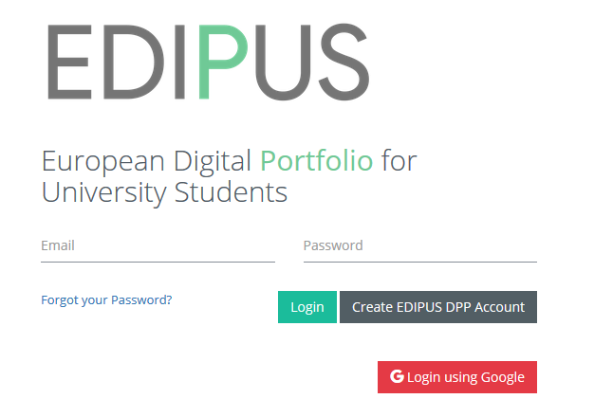
B2. Security Authentication
Authentication is used by platform and developers to make sure know exactly who is accessing their information. Also allowing platform to maintaining a close relationship with the users.
This project is supported by the EU. Any communication or publication related to the Project made by the beneficiaries jointly or individually in any form and using any means, shall indicate that it reflects only the author's view and that the NA and the Commission are not responsible for any use that may be made of the information it contains.

